Slide 1
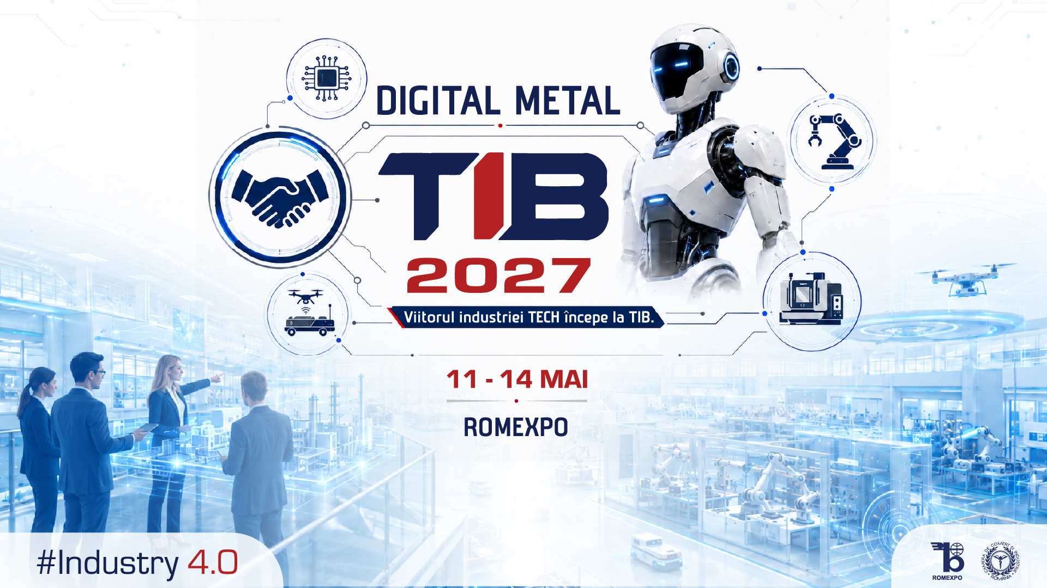
SALES DECK

Slide 2



A MARKET THAT IS CHANGING
A new chapter: DIGITAL METAL & TIB
The market demands digitalization, and ROMEXPO is answering with a major strategic shift. Starting in 2027, we are organizing DIGITAL METAL & TIB, an important step for the entire industry and a clear signal of alignment with the international standards of the sector.
International alignment
In line with major European trade fairs in the field
Unified ecosystem
The Metal community and the TIB community, under one brand
“The industry needs an event that speaks the language of digitalization, not just product displays. DIGITAL METAL & TIB is our answer to that need.”
Focus on Industry 4.0
Automation, robotics, predictive maintenance, software
OANA NETBAI, Commercial Director ROMEXPO

Slide 3




THE NEW CONCEPT
The reference platform for digital transformation
Industrial automation
Applied robotics
Predictive maintenance
Industry 4.0
Systems integration
Production software

Slide 4

ONE UMBRELLA BRAND
The convergence of the Metal and TIB communities
Integrated exhibition format, with shared thematic areas
METAL
TIB
Manufacturers, processors,
equipment suppliers
Systems integrators,
technology solutions
Networking program dedicated to cross-industry partnerships
DIGITAL
METAL
& TIB
Know-how transfer between complementary ecosystems
Joint positioning in an increasingly international market

Slide 5



THE MESSAGE THAT BRINGS VISITORS TO YOUR BOOTH
“How you take production to the next level”
At DIGITAL METAL & TIB, the specialist visitor comes to understand how to produce more efficiently, how to lower the cost per part, and which investments actually make sense for their factory. Every newsletter, post, and campaign asset carries this message forward.
How do you lower the cost per part?
How do you grow output without growing headcount?
How do you make better investment decisions?

Slide 6






THE CAMPAIGN'S STRONGEST PILLAR
Live Factory: the complete manufacturing flow, end to end
At the event, visitors discover how equipment integrates into a flow capable of eliminating downtime in production.
Raw material
Cutting
Processing
Measuring
& control
Assembly
Internal
logistics
Storage
& shipping
From raw material to finished part, see the entire production flow in one place, with live demonstrations at every stage and technical consulting right at the booth.

Slide 7

WHO ATTENDS THE EVENT
The visitors you'll meet at your booth
80%
20%
PRIMARY AUDIENCE
SECONDARY AUDIENCE
Automotive and machine-building plants
Metal structures
Come to lower the cost per part without compromising precision
HVAC
Appliances / electrical
Metal processing and fabrication plants
Electronics / EMS
Looking for solutions across the whole flow: material, cutting, welding, measuring, assembly
Energy / PV
Furniture
See live quality-control and automation flows integrated into production, right at the booths.

Slide 8



TECHNOLOGY FOR EXHIBITORS
The ROMEXPO lead-generation app
Every visitor scanned at your booth automatically becomes a qualified lead, straight into your own database, ready for follow-up.
Instant lead generation
Your own database
Direct contact with the visitor
Scan the visitor's badge and automatically receive their contact details, no paper and no manual entry
Every lead goes straight into your database, exportable and available immediately after the event
Add notes and specific interests on the spot, for a fast, personalized follow-up
No paperwork, no lost data: everything stays in your exhibitor account.

Slide 9

VALUE FOR EXHIBITORS
Why exhibit at DIGITAL METAL & TIB 2027
Direct access to decision-makers
Live demonstrations, not brochures
Direct consulting at the booth
Plant managers, engineers, and technicians with real investment decision power
Visitors see the technology at work: robots, measurement cells, cutting and welding lines
Real technical discussions, no intermediaries, with plant specialists
International positioning
Cross-industry networking
A message built on results
Aligned with the standards of major European industrial digitalization trade fairs
Partnerships between the Metal and TIB communities, under one brand
The campaign emphasizes decisions and outcomes, not technology spectacle

Slide 10
HOW WE BRING VISITORS TO YOUR BOOTH
The 3 pillars of the communication campaign
01
02
03
Efficiency you can see in the costs
The factory of the future
Live Factory at DIGITAL METAL & TIB
Where profit margin is lost on the factory floor, and which solutions recover the cost: automation, control, optimized consumption.
What it looks like in practice when automation, measurement, and execution work in the same digital flow.
The complete manufacturing flow, from raw material to finished part, seen and tested live at the event.
Supported through: themed newsletters, social media campaigns (5 content types), problem-solution posts, and the “Live Factory” series.

Slide 11
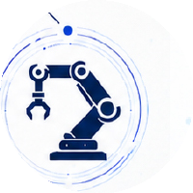
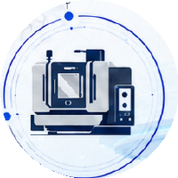


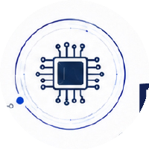


RESERVE YOUR SPOT
Be part of the new generation of
DIGITAL METAL & TIB
May 11-14, 2027
ROMEXPO, Bucharest
Plan your participation early for the best exhibition terms and optimal positioning within the event's new concept.
CONTACT US
romexpo@romexpo.ro
www.digitalmetal-tib.ro

